Slide 1
Account payable operations module in Oracle E-Business suite
Prepared by:
Ahmed Mohamed Abdelhamid Basher Zeyad Salam Karim Hany
Belal Ali
Track:
Oracle Digital Accounting Specialist
Under supervision of:
DR/ Mohamed Sobhy

Slide 2
Our Agenda For Today
What’s meant by Account payable ?
How does the Account payable integrated with oracle ?
How to define new supplier ?
How to create new Invoice?
Payments , Void, Refund, Report and close the period ?

Slide 3
What’s meant by
Account payable ?
Accounts Payable refers to the money a company owes to its suppliers or vendors for goods or services it has received but not yet paid for.
It includes things like:
- Supplier invoices
- Payment schedules
- Credit memos
-Purchase orders (linked to invoices)

Slide 4
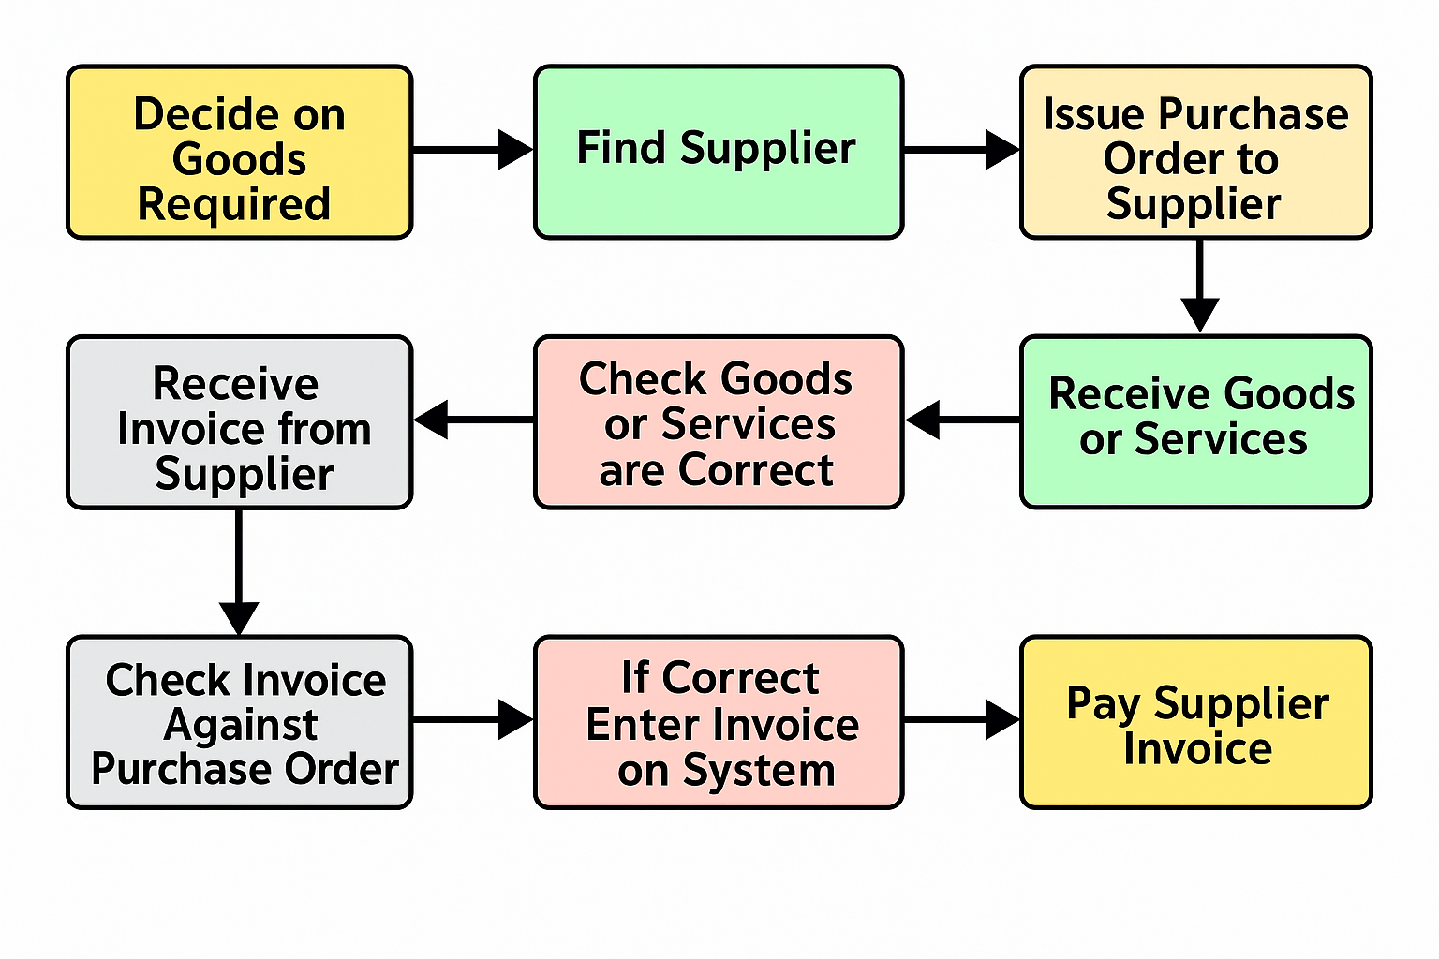
Accounts payable process

Slide 5
Account payable Integration with Oracle
Invoice Entry
PO Matching
Approval Workflow
Payments
General Ledger Posting
Cash Management

Slide 6
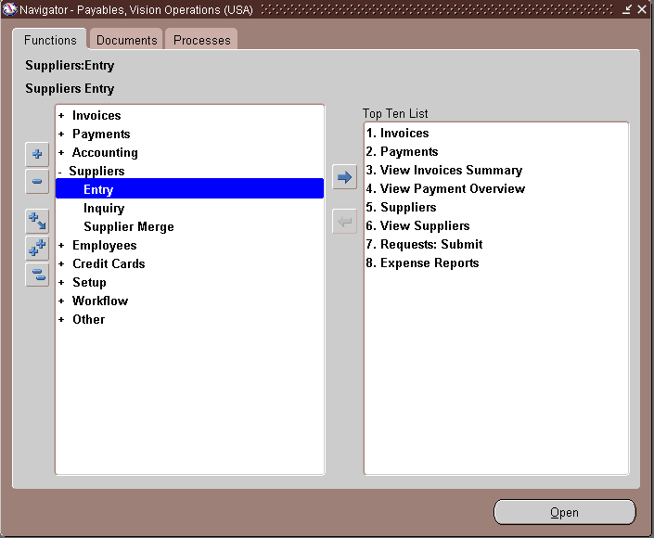
Define New Supplier
First step to define new supplier is to open the “payables vision operation”.
choose supplier tab then Entry.

Slide 7
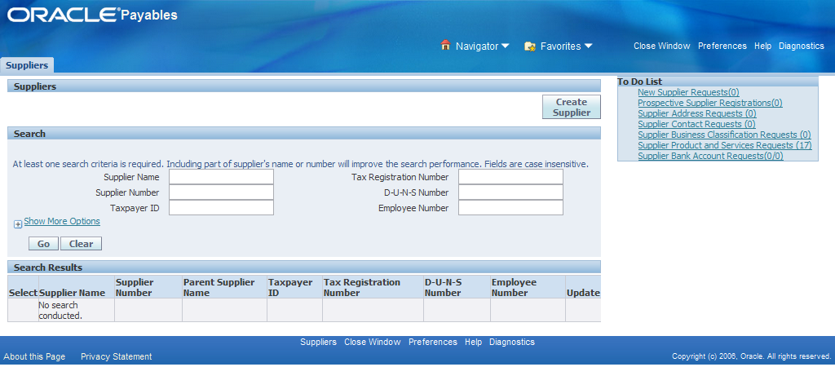
Define New Supplier
- we can search for an existing supplier by Name, Number, ID…..
- To create new supplier, we have to press on the “Create Supplier tab” on the top left corner.

Slide 8
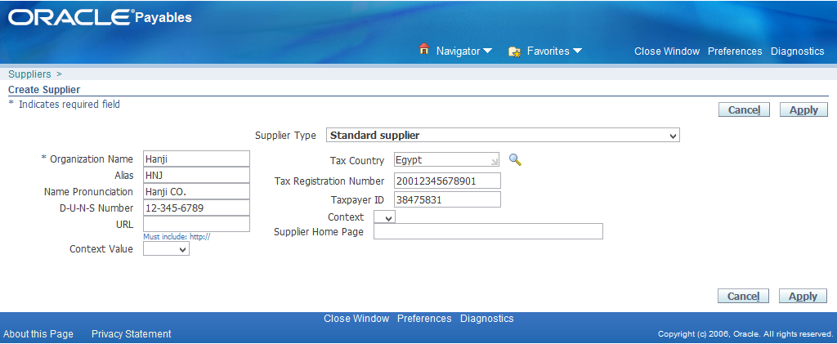
Define New Supplier
- First thing to be recorded is the “Organization Name”
- Organization name is the only Mandatory field in this page and you can’t continue recording the supplier without it.
- The other fields are optional to be filled and you can edit them after you finish and save the all recorded data of the supplier.
- After Finish recording, Press Apply.

Slide 9
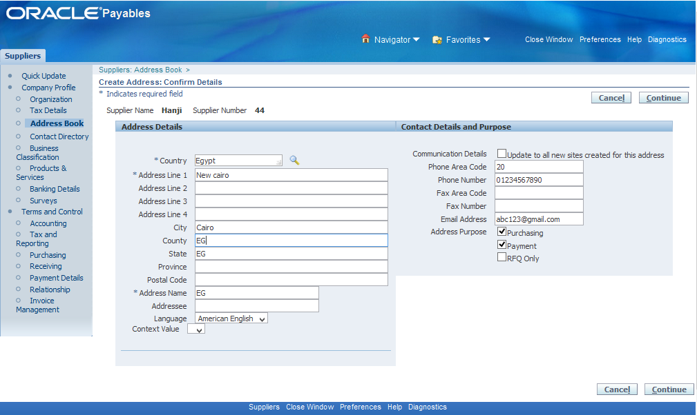
Define New Supplier
- Next we transfer to the Address book to record other Mandatory information related to the Supplier as: Country, Address, City, County, State …..
- Those are Mandatory Information which are essential to be recorded and will appear during recording the invoice batch.

Slide 10
Define New Supplier
- Another important thing to be taken into consideration is the Address book.
- Each address can be assigned a specific “Address Purpose”.
- This tells the system what business function that address should serve.

Slide 11
Define New Supplier
- Purchasing checked If your company is buying items from a supplier, this is the address where those POs will be sent (electronic or physical).
- Payment is used by the Payables module to send payments, such as checks or remittance advice.
- RFQ (Request for Quotation)
A document asking the supplier for pricing and terms before a PO is issued.

Slide 12
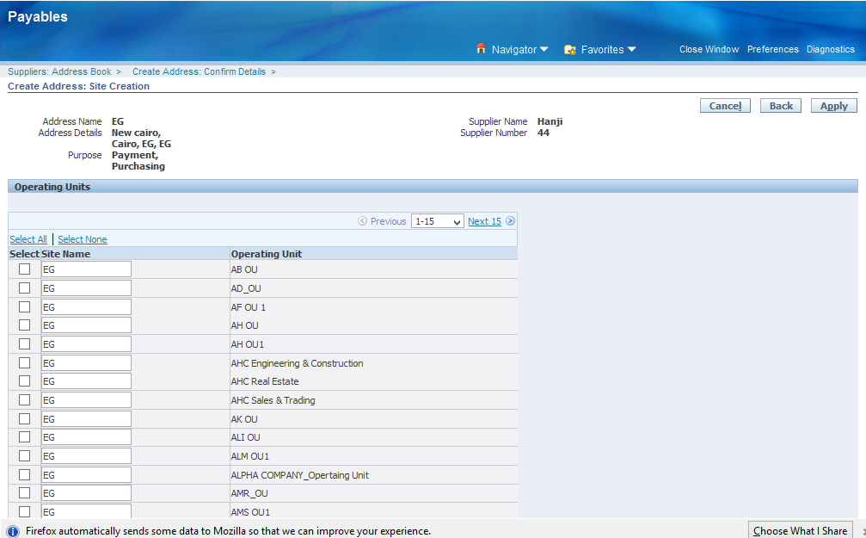
Define New Supplier
- After pressing continue we then transfer to the page where we choose our operating units.
- Operating unit represents a business division or line of business within your enterprise that performs daily business operations like purchasing, invoicing, and payment processing.
- In our Case we choose AH OU.
- After we finish press Apply.

Slide 13
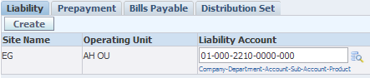
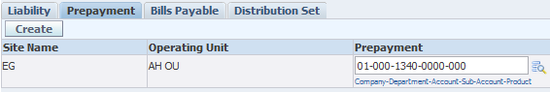
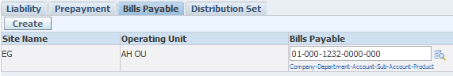
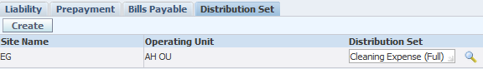
Define New Supplier
- Now at the final part we it’s the time to assign the financial data related to the supplier that we will use during work .
- First one is to assign the Liability data.
- Second one is to assign the payment data.
- Third one is to assign the Bills payable data.
- Fourth one is to assign the Distribution set data.
- After finish we press Save then it’s the time for opening new Batch and record new Invoice.

Slide 14
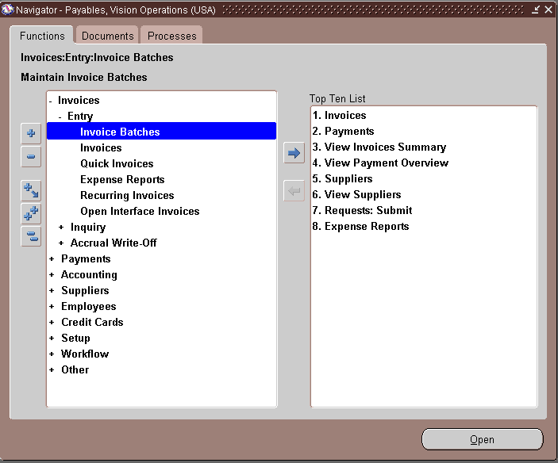
Record New Invoice
- Now is the time to make new Invoice Batch so as to record new Invoice
- Through the Navigator, choose Invoices – Entry – Invoice Batches

Slide 15
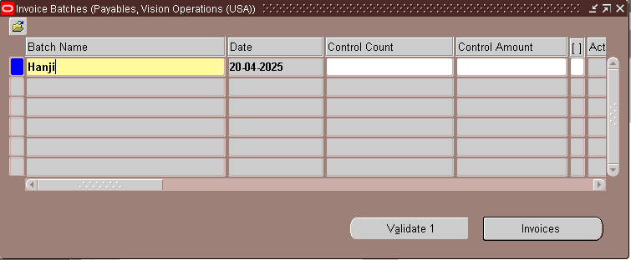
Record New Invoice
- To start recording we have to Write the Name of our Batch.
- After writing it, Click on the Invoice Button to access the Invoice window.

Slide 16
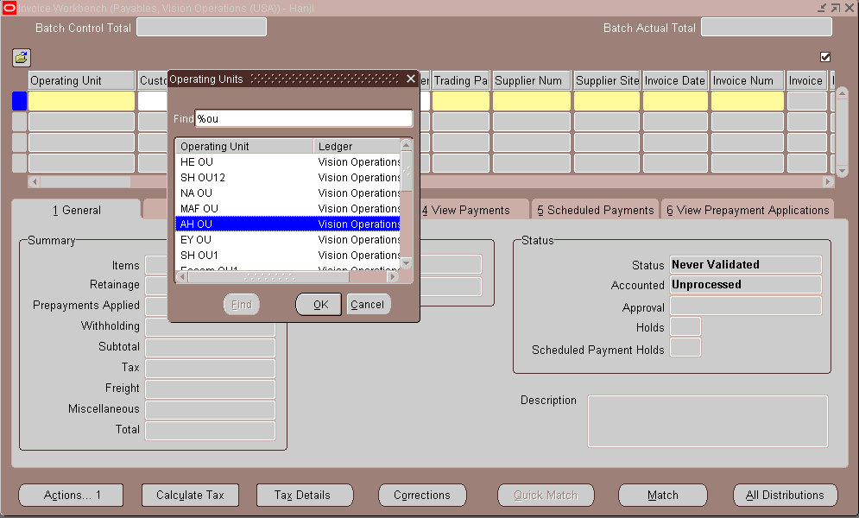
Record New Invoice
- After Opening the Invoice window we have to choose our Operating unit
- The operating unit we used to use was AH OU

Slide 17
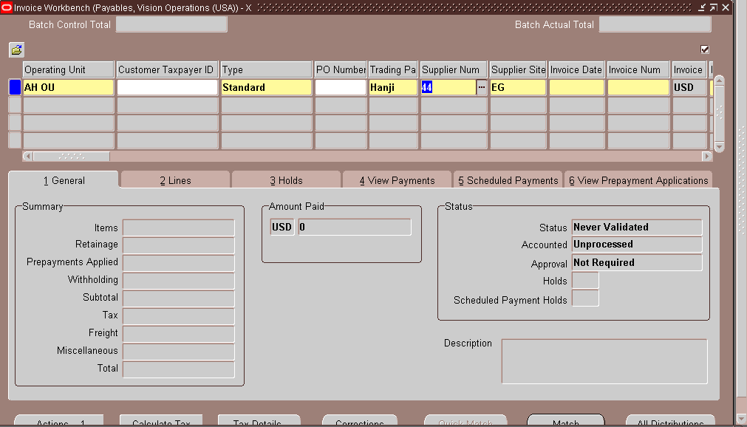
Record New Invoice
- After choosing the operating unit its time to choose our supplier.
- We can search him buy using supplier number or using trading Partner.

Slide 18
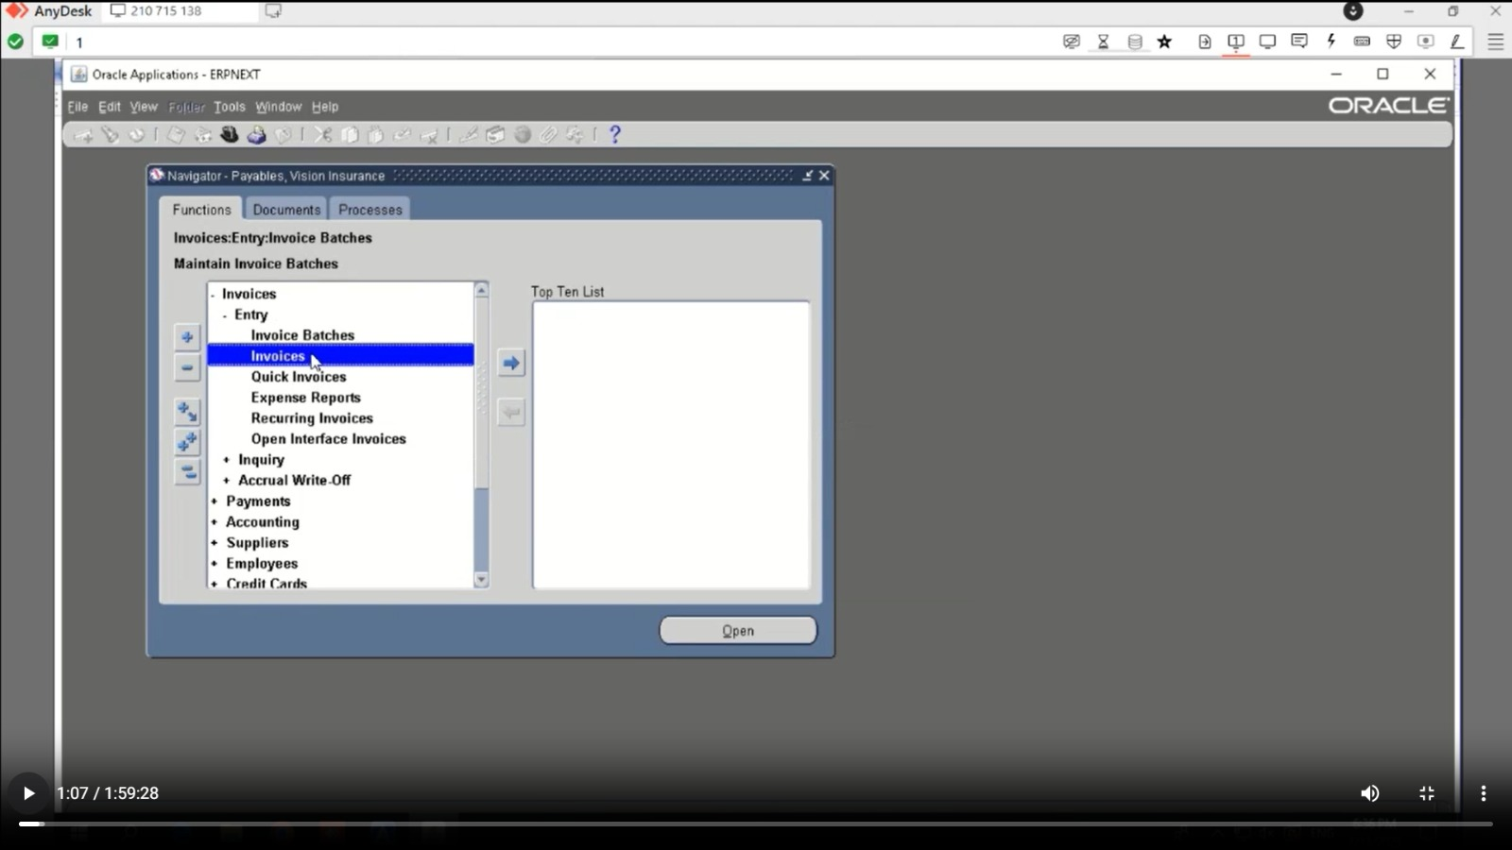
Record New Invoice
1. Navigation Path:
Payables > Invoices > Entry > Invoices

Slide 19
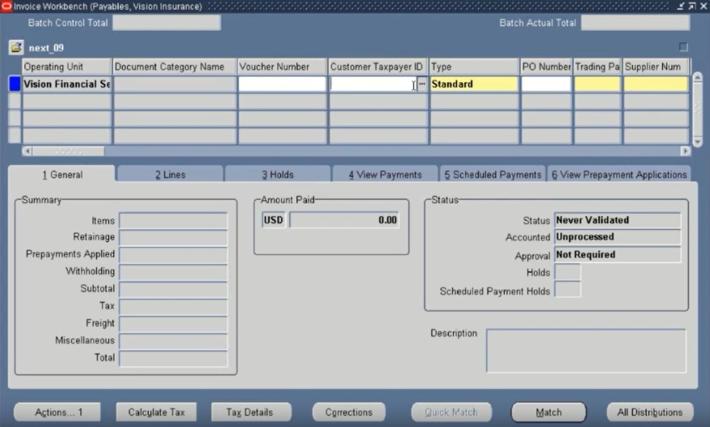
Record New Invoice
2. Enter Invoice Details:
Invoice Type:
Standard
Prepayment
Credit Memo
Supplier Name
Supplier Site
Invoice Number
Invoice Date
Invoice Amount
Currency

Slide 20
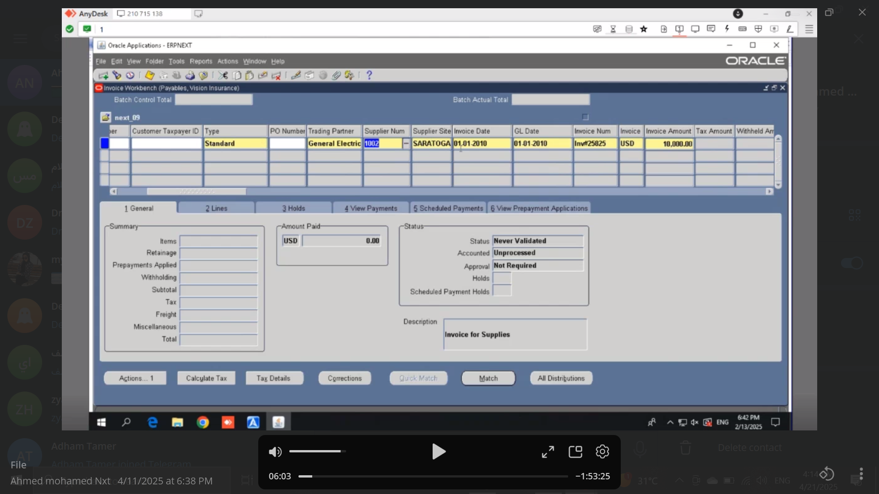
Record New Invoice
2. Enter Invoice Details:
Invoice Type:
Standard
Prepayment
Credit Memo
Supplier Name
Supplier Site
Invoice Number
Invoice Date
Invoice Amount
Currency

Slide 21
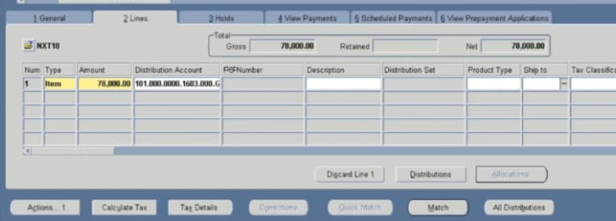
Record New Invoice
3. Distributions
Click on the “Lines” tab
Enter Distribution Line:
Amount
Distribution Account

Slide 22
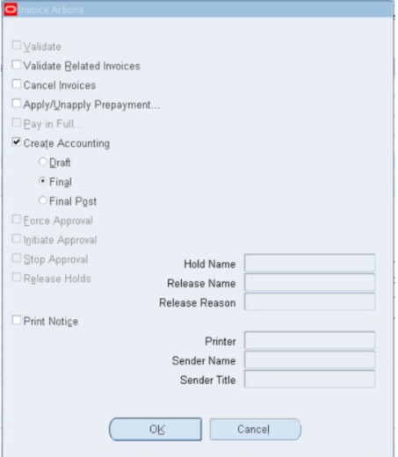
Record New Invoice
4. Validate Invoice:
Click Actions > Validate
Create Accounting:
Click Actions..1 > Create Accounting > Final > OK

Slide 23
Recurring invoice
It is an invoice that is repeated monthly with the value, date and expenses that you want to make this invoice you must do some steps:
Distribution Set
create recurring invoice
Special Calendar

Slide 24
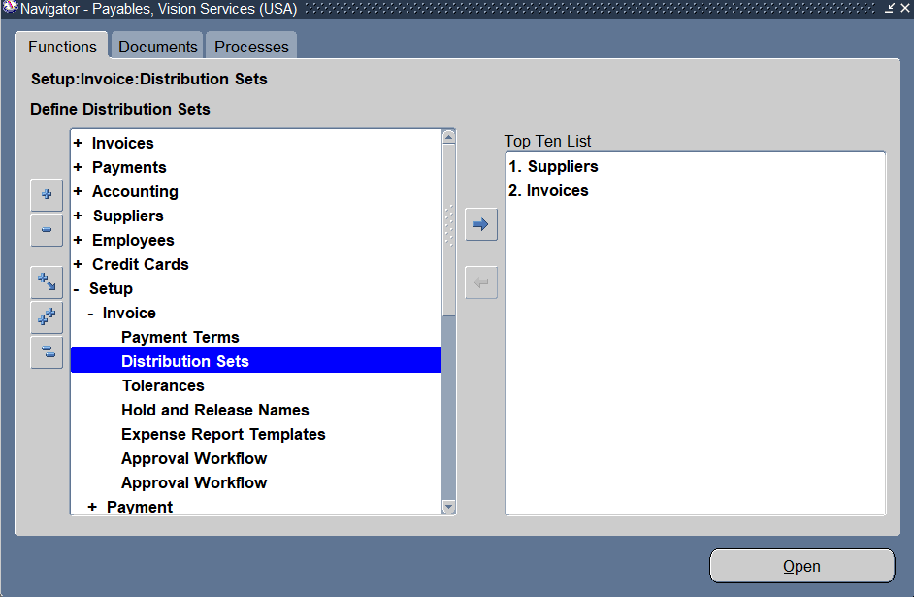
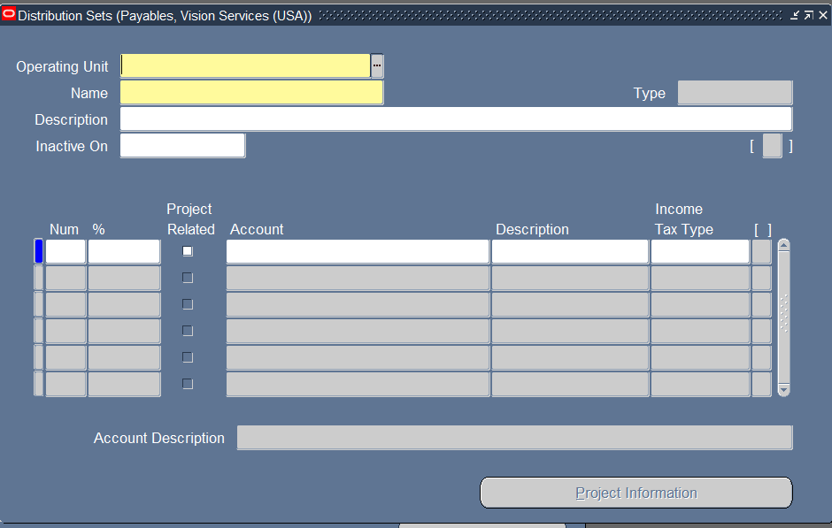
Distribution Set
Setup → Invoices →Distribution Sets.
Define the Distribution Set In the Distribution Sets window, click on New to create a new set.
Enter a Name and Description for the Distribution Set.

Slide 25
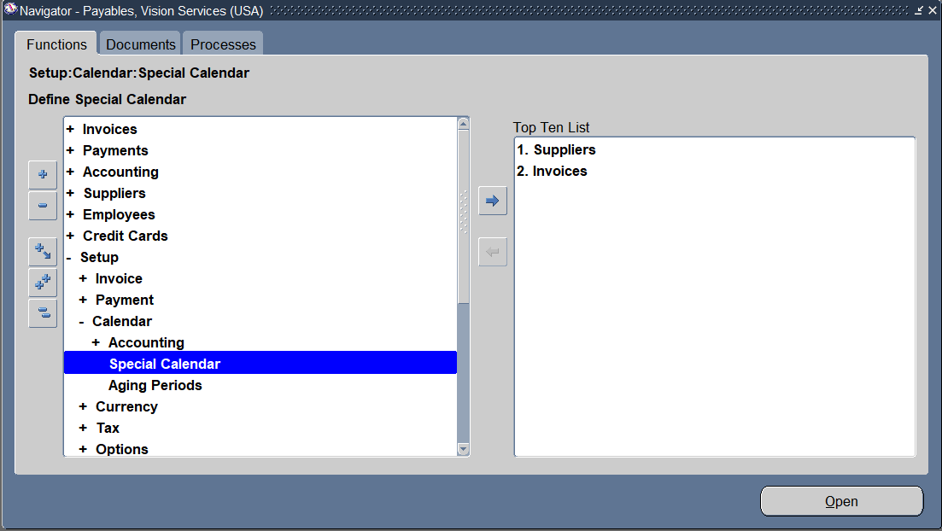
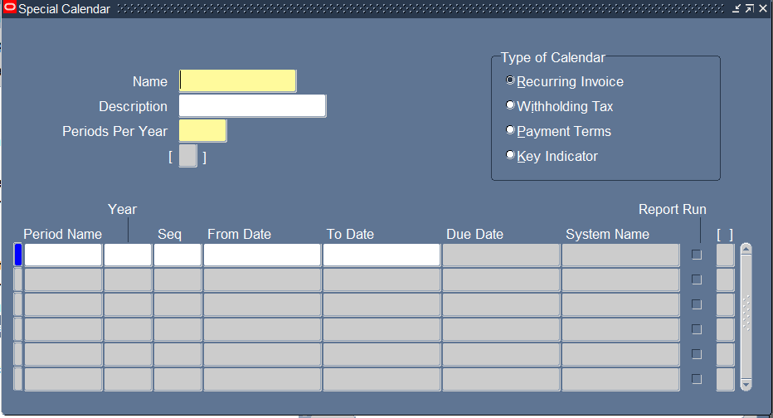
Special Calendar
Setup > Calendar > Special Calendar

Slide 26
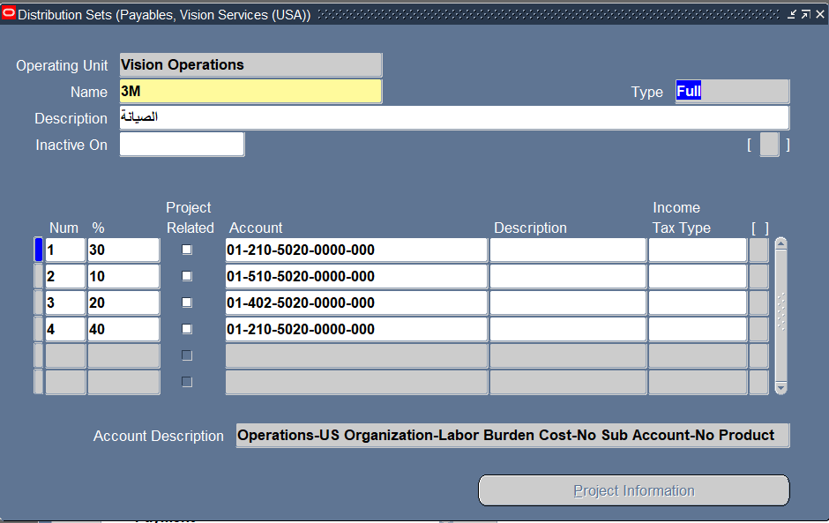
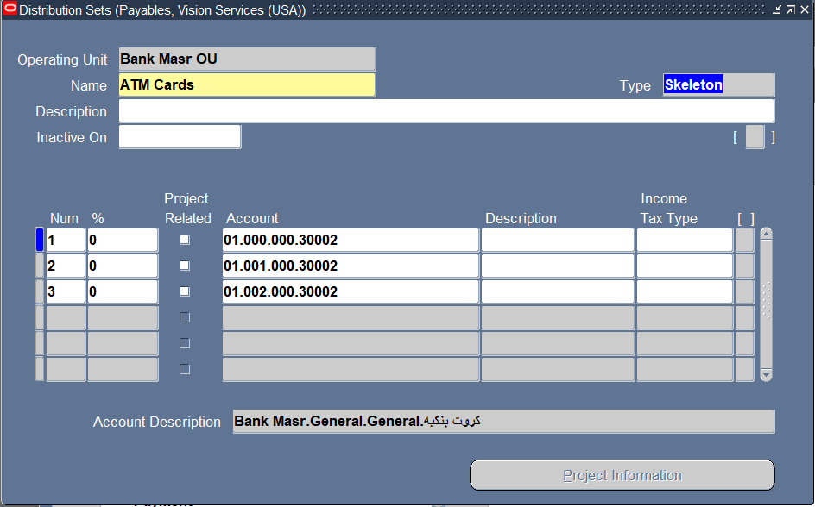
Choose the Type:
Skeleton
Define accounts without specifying percentages; amounts are entered during invoice entry.Oracle Documentation
Full
: Specity exact percentages for each account.

Slide 27
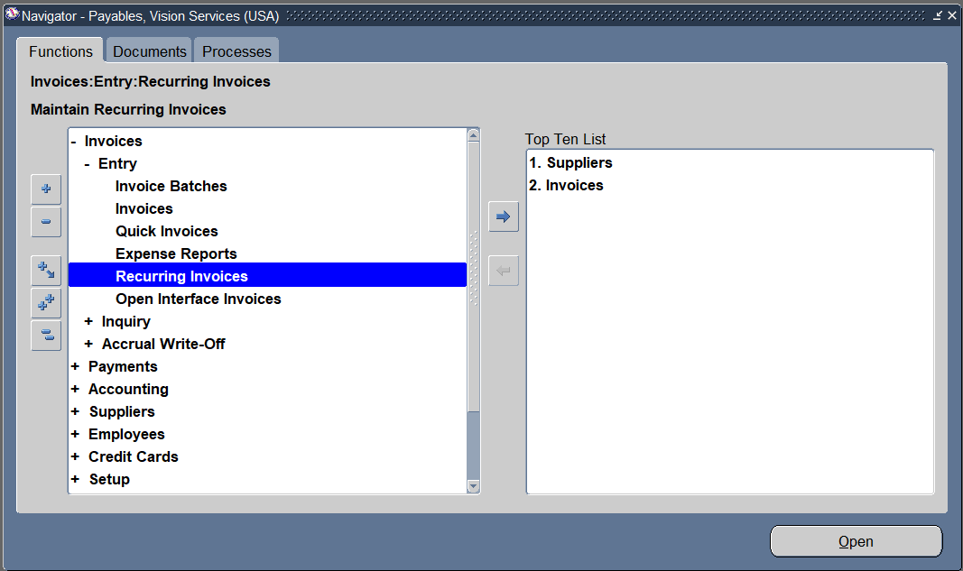
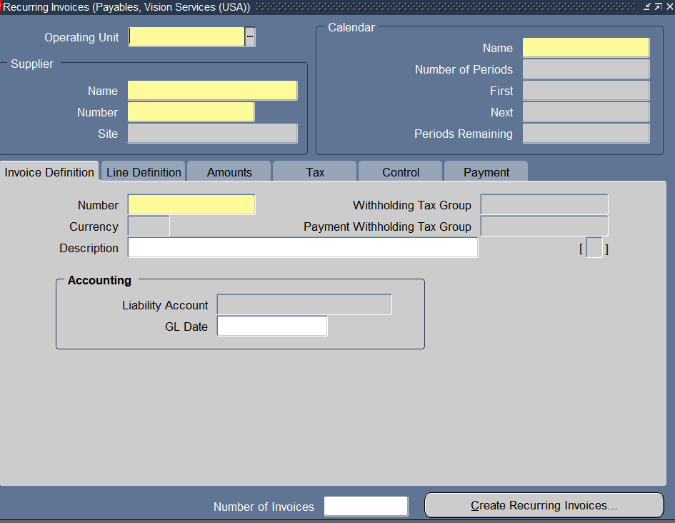
create recurring invoice
Invoice → Entry → Recurring invoice
Click on line definition
Click on payment to choose terms ,pay group and payment method

Slide 28
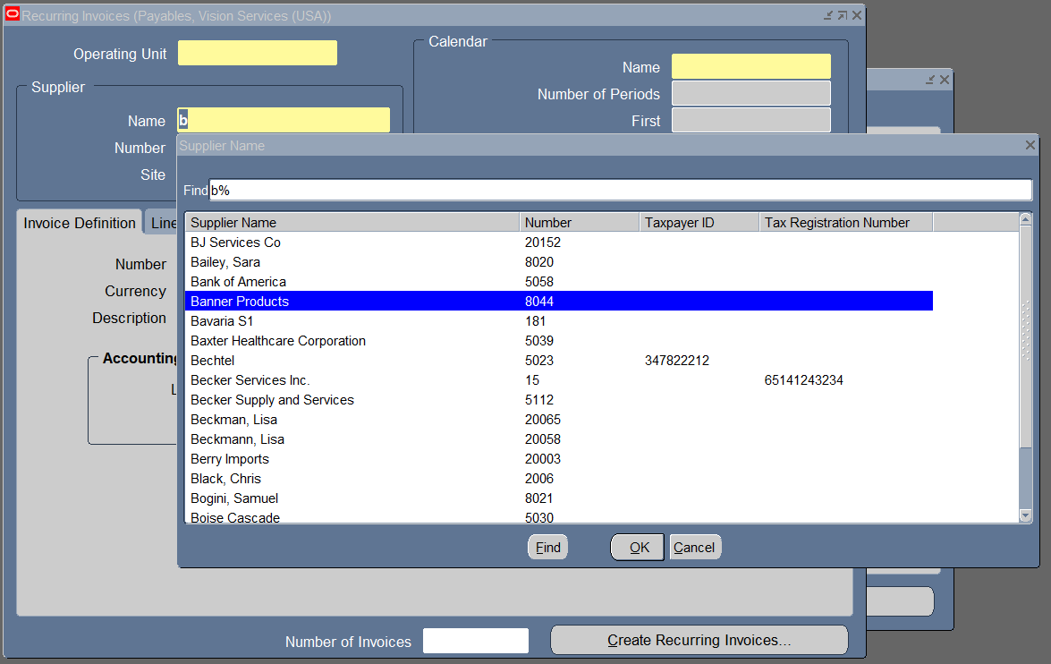
Select the Operating Unit
Supplier
Supplier Name - Choose the supplier for whom the recurring invoice is being created.
Supplier Site - Select the supplier's Pay Site (must be set up for Payables).
Calendar
Calendar Name - Choose the Recurring Invoice Calendar defined earlier.
Select the number of periods
Recurring Frequency - E.g., Monthly, Quarterly

Slide 29
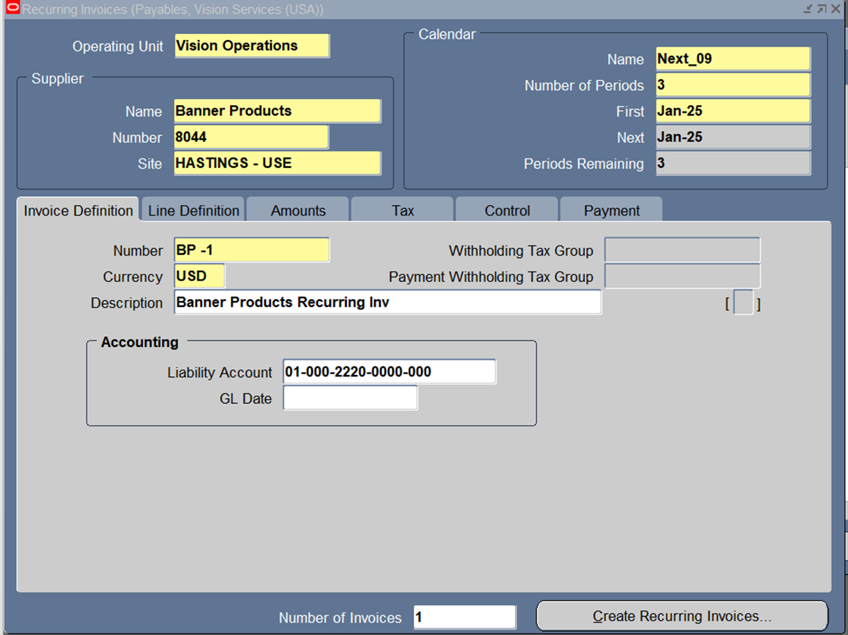
Invoice Definition
Invoice Number - This is a reference template name (not an actual invoice yet).
Invoice Currency - Defaults from supplier, but can be changed.
Distribution (Optional) - If predefined, can allocate the cost across accounts.

Slide 30
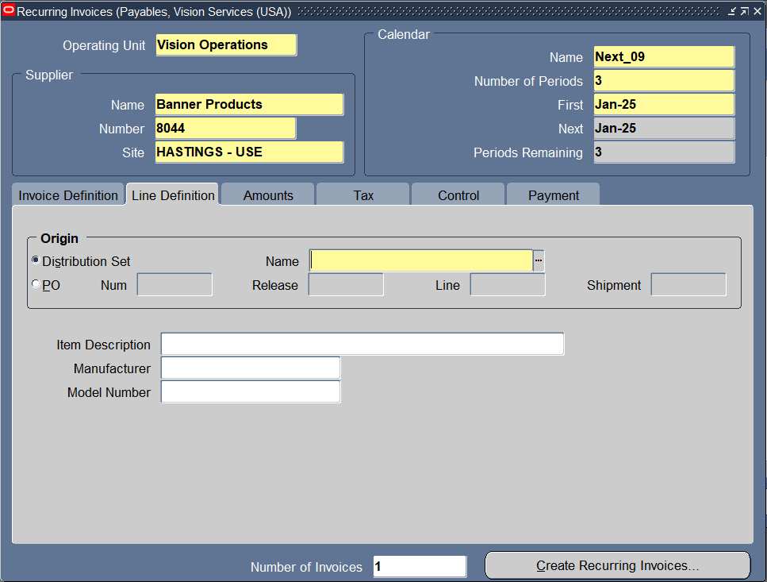
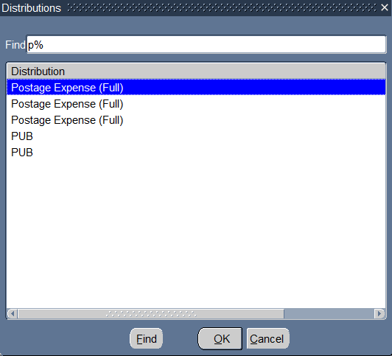
Line Definition
Line name - Identify the need you knew about.

Slide 31
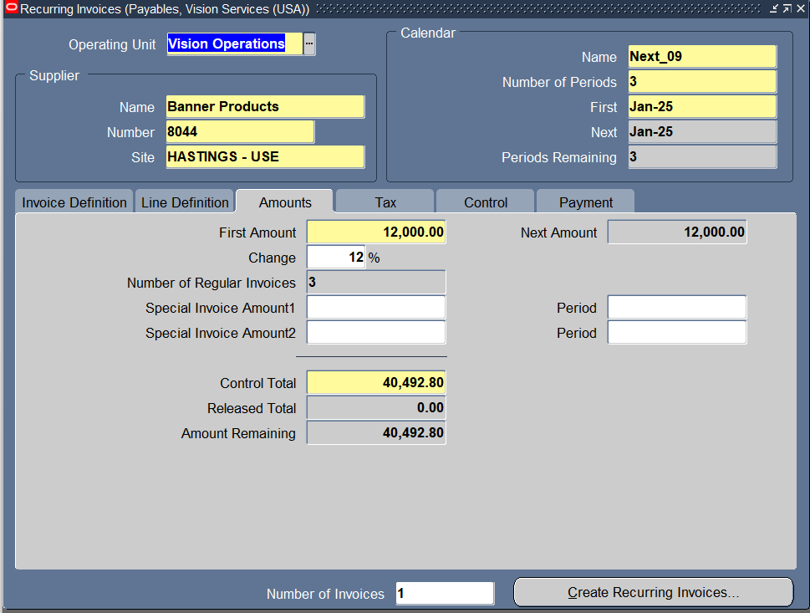
Line Definition
Line name - Identify the need you knew about.
AmountS
In this field we have to the Fixed amount.

Slide 32
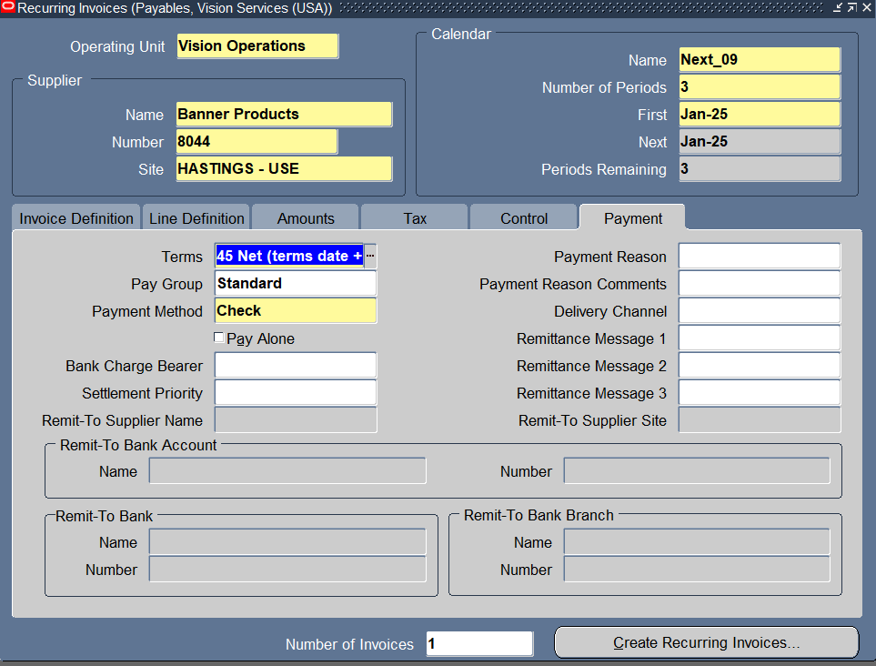
Payment
In the payment tab we have to assign the Tearms, Pay Group and Payment method.
Also we have to defign the OU, Name,Number and the site

Slide 33
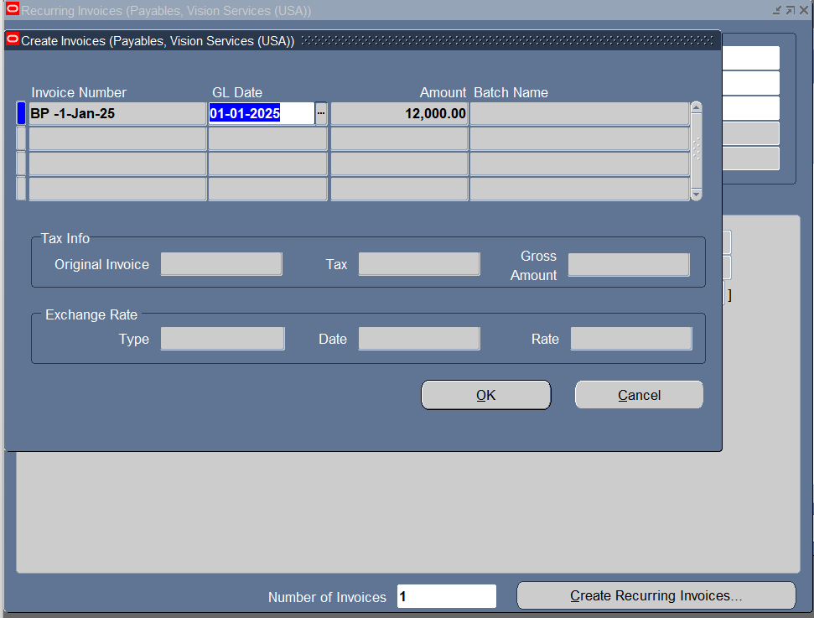
Payment
In the payment tab we have to assign the Tearms, Pay Group and Payment method.
Also we have to defign the OU, Name,Number and the site
Click create Recurring invoices
Click OK, then Submit the request.

Slide 34
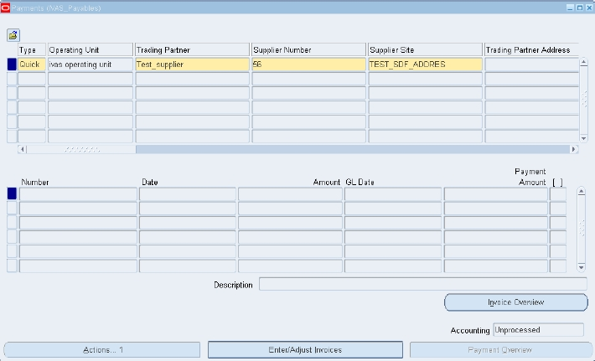
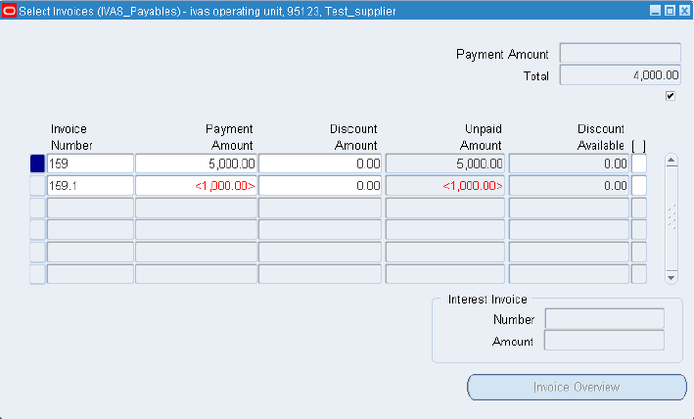
Payment From Work Bench
Payment From Work Bench :
Involves processing payments for multiple invoices from a centralized interface, used for handling payments in bulk or batches.
1- Payments > Entry > payments
2- enter details required
3- Then click on Enter/Adjust invoices

Slide 35
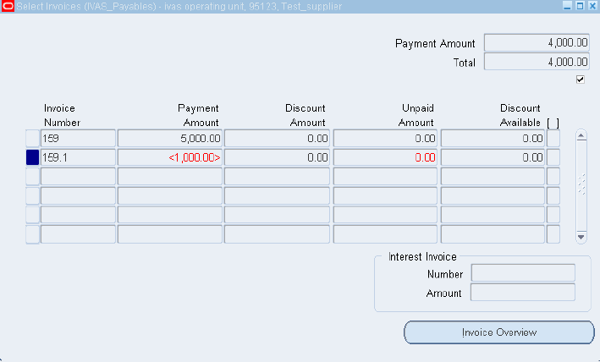
1- Select the Invoice numbers for which payment
2- Save your work and check the payment amount
3- Check the payment is made for both the invoice

Slide 36
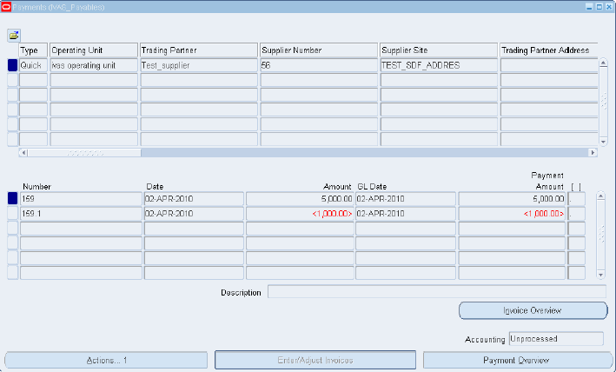
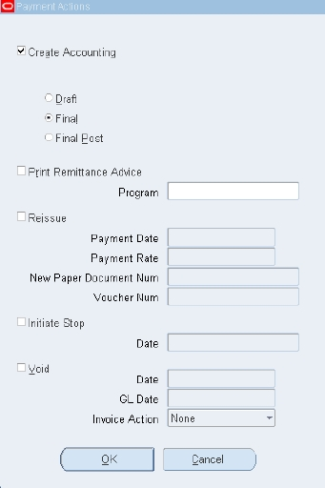
1- Click on Actions
2- Choose Create Accounting
3- Choose final
4- Ok

Slide 37


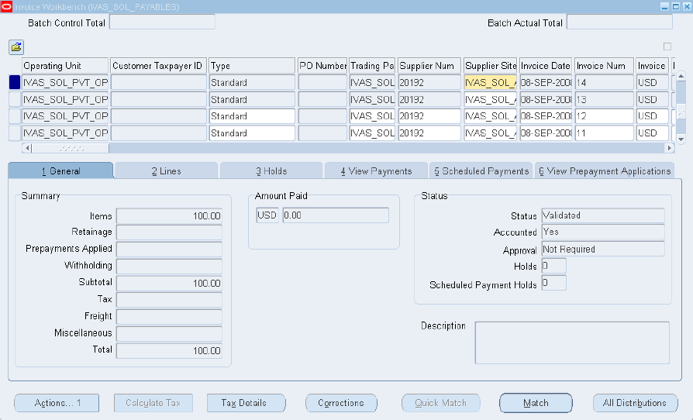
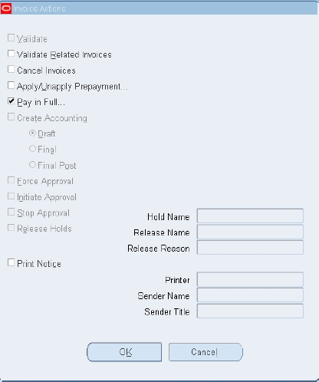
Single Payment Entry

Slide 38
Single Payment Entry : Involves creating and processing a single payment for specific invoices, used for individual or selected invoices.
1- Invoices > Entry > invoices
2- Identify the invoice you want to pay
3- Click on Actions
4- Click on Pay In Full
5- Ok

Slide 39
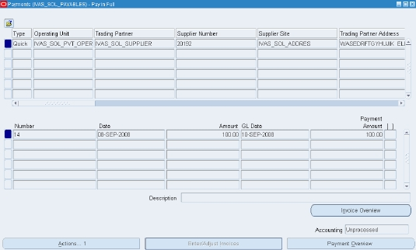
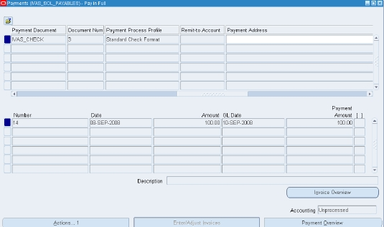

Slide 40
1- Type: Quick and enter details required
2- The payment method: check
3- Click on Actions
4- Choose Create Accounting
5- final
6- Ok

Slide 41
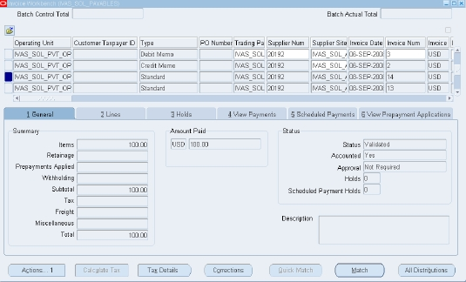
- Back to the invoice
- Note that total amount paid in a single payment

Slide 42
Void Payment
Go to Payments Workbench
Select the payment
Click on Actions button

Slide 43
Void Payment
Go to Payments Workbench
Select the payment
Click on Actions button
Choose 'Void'
Select Invoice Action: None (void payment only)
Click OK to complete

Slide 44
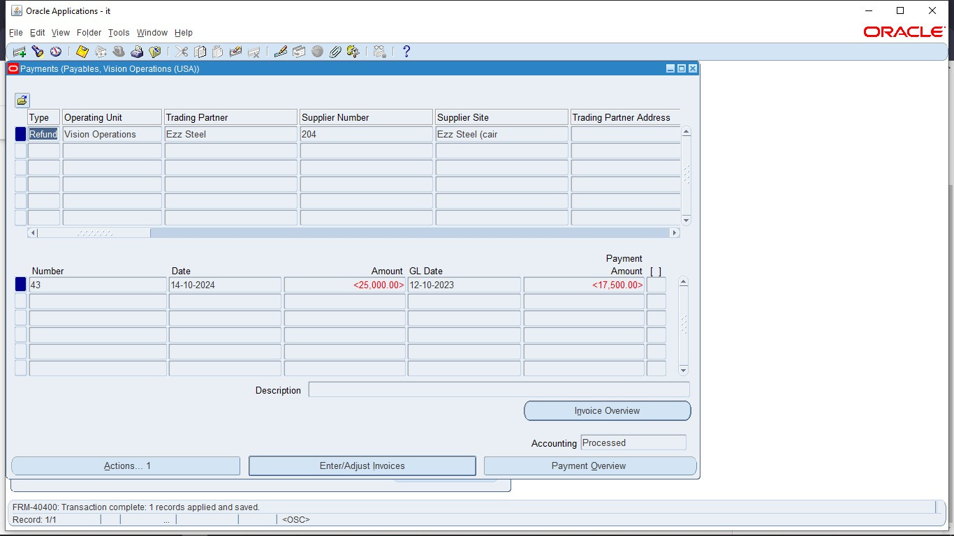
Refund Process
1. Create a negative amount invoice
2. Enter required details
3. Save the invoice
4. Click on Actions button
5. Choose 'Create Accounting' > Final > OK

Slide 45
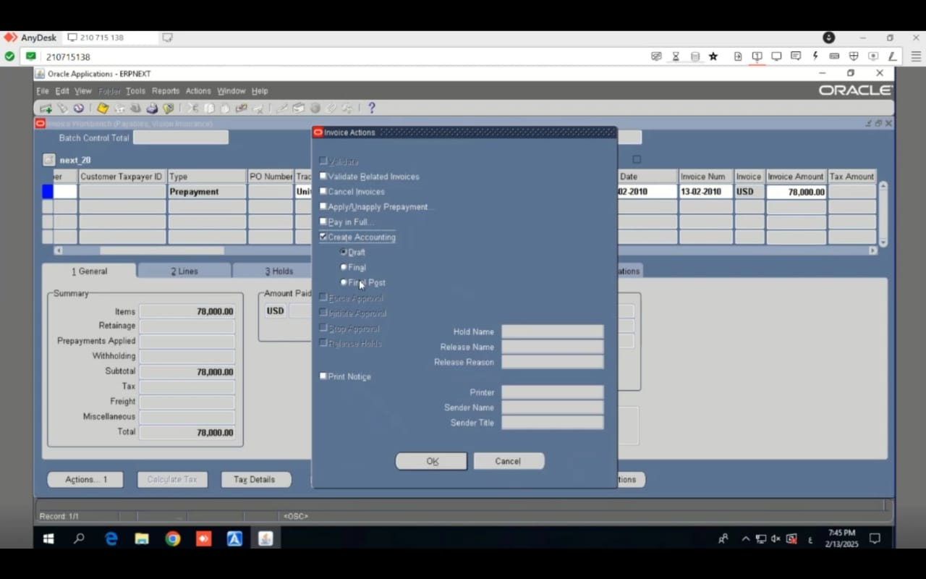
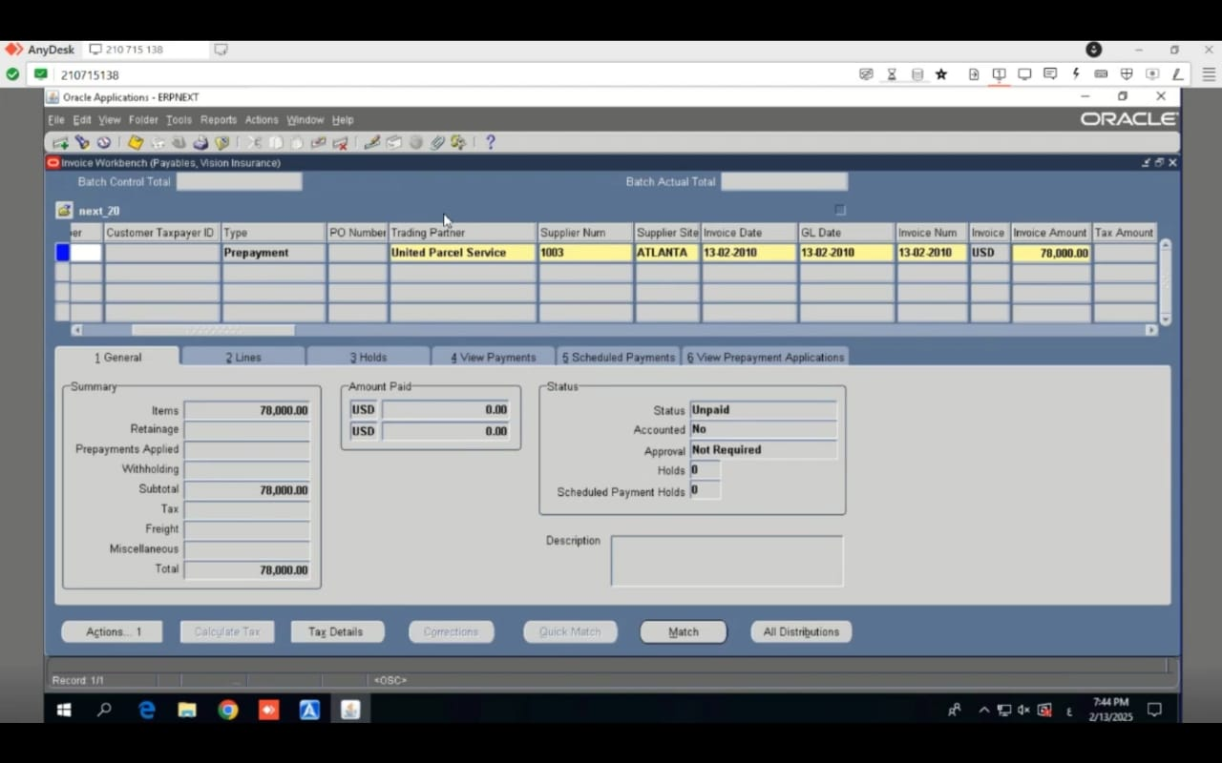
Apply Prepayment
1. Identify the prepayment invoice
2. Actions > Pay In Full >

Slide 46
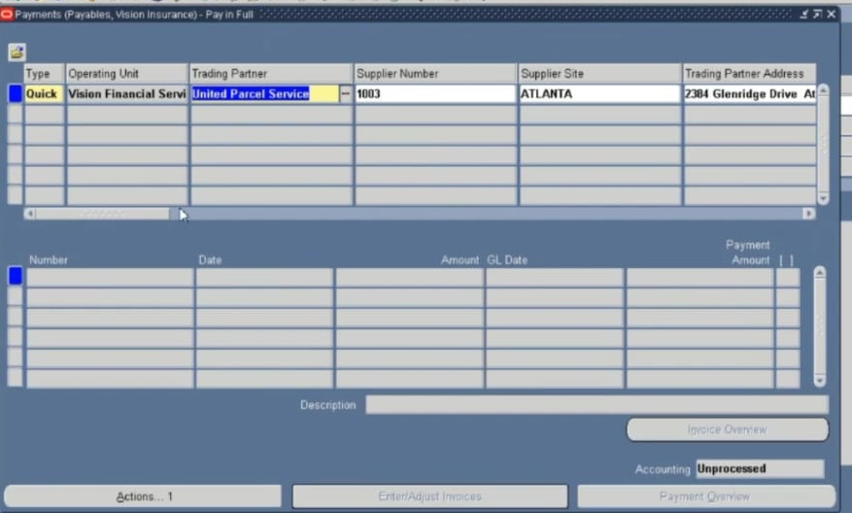
Apply Prepayment
1. Identify the prepayment invoice
2. Actions > Pay In Full > Enter payment details

Slide 47
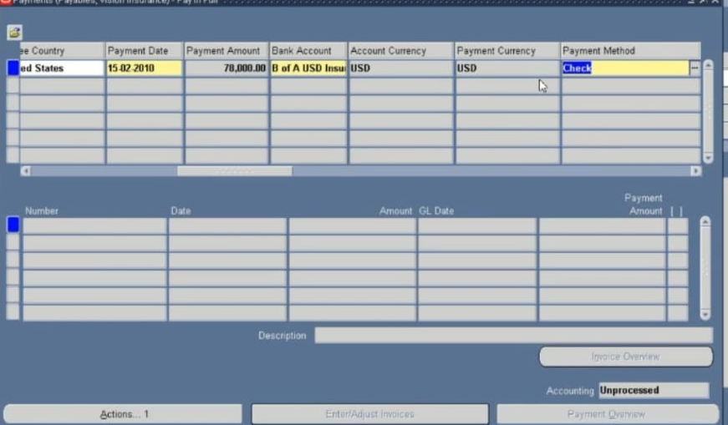
Apply Prepayment
1. Identify the prepayment invoice
2. Actions > Pay In Full > Enter payment details

Slide 48
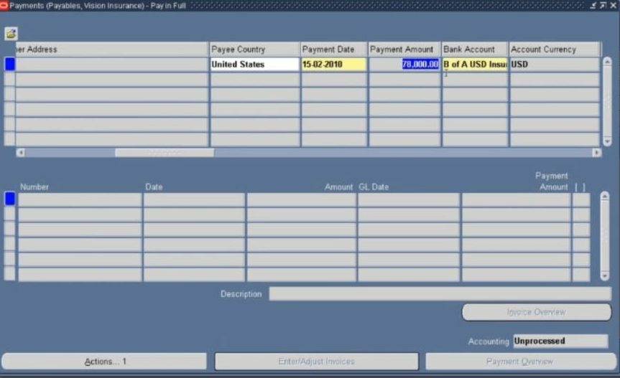
Apply Prepayment
1. Identify the prepayment invoice
2. Actions > Pay In Full > Enter payment details

Slide 49

Apply Prepayment
1. Identify the prepayment invoice
2. Actions > Pay In Full > Enter payment details
3. Create Accounting > Final > OK

Slide 50

Apply Prepayment
1. Identify the prepayment invoice
2. Actions > Pay In Full > Enter payment details
3. Create Accounting > Final > OK
4. Back to prepayment invoice (Status: Available)

Slide 51

Apply Prepayment
1. Identify the prepayment invoice
2. Actions > Pay In Full > Enter payment details
3. Create Accounting > Final > OK
4. Back to prepayment invoice (Status: Available)
5. Actions > Apply/Unapply Prepayment

Slide 52

Apply Prepayment
1. Identify the prepayment invoice
2. Actions > Pay In Full > Enter payment details
3. Create Accounting > Final > OK
4. Back to prepayment invoice (Status: Available)
5. Actions > Apply/Unapply Prepayment
6. Select invoice and apply amount

Slide 53

Transfer to General Ledger
1. Run 'Create Accounting' from View > Requests
2. Submit with mode: Final
3. Use 'Transfer Journal Entries to GL'
4. Ensure all transactions are successfully transferred

Slide 54

Close Payables Period
1. Navigate: Accounting > Control Payables Periods
2. Change status of the period to 'Closed'

Slide 55

Close Payables Period
1. Navigate: Accounting > Control Payables Periods
2. Change status of the period to 'Closed'

